Slide 1
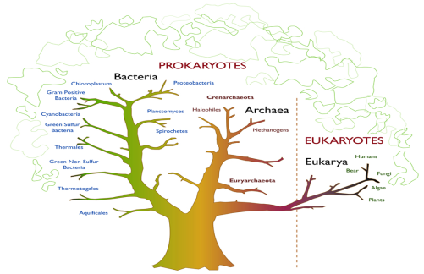

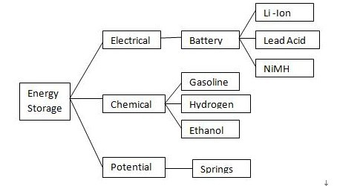
Classification Trees Testing
Testing Constrained Combinations
Vera Pironska
QA Engineer
XAML Team 1
Telerik QA Academy

Slide 2

Table of Contents
What is Classification Trees Testing
Constructing Classification Trees and Test Cases
Tool Support
CTE XL - Graphical Editor For Classification Trees
Some Useful Tips

Slide 3
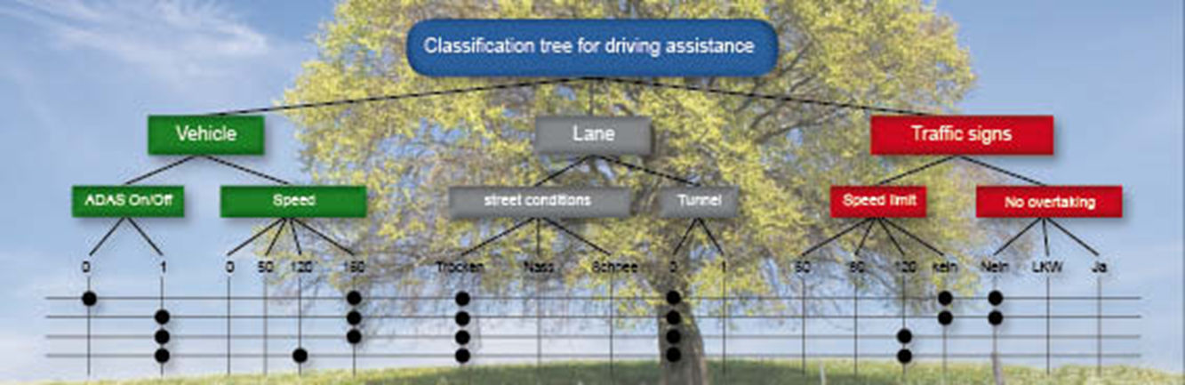
What Is Classification Trees Testing
Main Concepts

Slide 4

Constrained Options
In some cases separate factors in a system are constrained
Certain options for one factor won't coexist with certain options for another factor

Slide 5

Classification Tree Method
Classification Tree Method:
A black-box test design technique
Test cases are designed to execute combinations of representatives of input and/or output domains
Test cases are described by means of a classification tree
Based on the functional specification of the test object

Slide 6
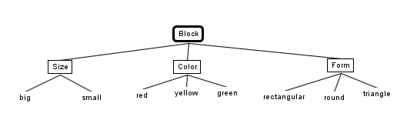
What Is a Classification Tree?
Classification tree:
A tree showing equivalence partitions hierarchically ordered.
Used to design test cases in the classification tree method.

Slide 7
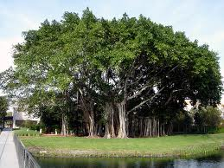
When Do We Use Classification Trees?
Classification trees are used as a way to test constrained combinations of factors
They also allow us to test some factors more heavily than others

Slide 8

Advantages of Classification Trees
Help for easy generating and maintaining test cases
Classification trees can provide precise information about coverage
They help to reduce documentation

Slide 9

Benefits & Rewards From Using CT
Maintenance of test cases
Easier & more cost effective
Visibility of testing scope
For new projects
Regression testing
User buy-in
Great visual for gaining acceptance
Exports to other testing techniques and tools

Slide 10

Constructing Classification Trees and Test Cases
Main Steps of the Process

Slide 11
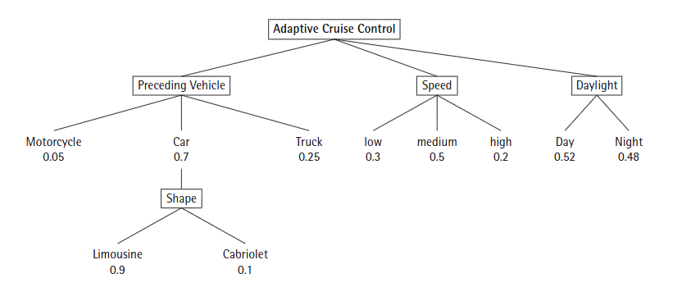
A Classification Tree Example
This is a simple example of a classification tree for an Adaptive cruise control system

Slide 12

Aspects of Interest
Identifying aspects of interest
The first activity performed for each testing problem when applying the technique of classification trees testing
Represent a collection of things that are supposed to interact in some interesting way
Things, which combinations the tester wants to test
E.g., blocks

Slide 13

Identifying Classifications
Identifying classifications within the areas of interest
The things that are supposed to interact with each other
In some cases subclassifications for one or more classifications will be identified
E.g., size, color, form

Slide 14
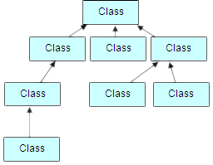
Identifying Classes
Classes have to be identified for each classification
Performed by using standard equivalence partitioning and boundary value analysis
Classifications identification can be recursively applied to classes

Slide 15
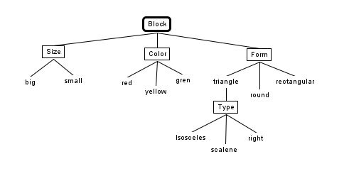
Aspects of Interest, Classifications, Classes - Example
Aspect of interest
Classification
classes
Another classification level
Another class level

Slide 16

Defining the Combination Rules
In order to derive test cases we need to define rules for combining the classifications in a tree
Do we want pairs of all factors?
Triples of some factors?
Are there exclusions, i.e., classes that can't combine?
Etc.

Slide 17
Generating Test Cases
Once the combination rules are defined – test cases can be generated
Test cases can be defined by combining classes from different classifications
A "leaf" is selected for each base classification
Classes that belong to the same classification are non combinable
By definition classes are disjunctive

Slide 18

Separating Specification From Data
A Classification Tree specifies test cases, but it does not specify test data
Implementation of a test case specification into concrete test data is a separate procedure

Slide 19
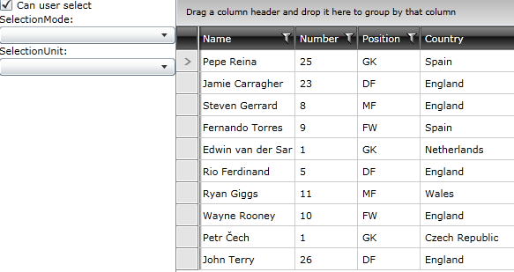
Creating a Classification Tree for a GridView Selection Properties
Demo

Slide 20

Tool Support
For Classification Trees Testing

Slide 21
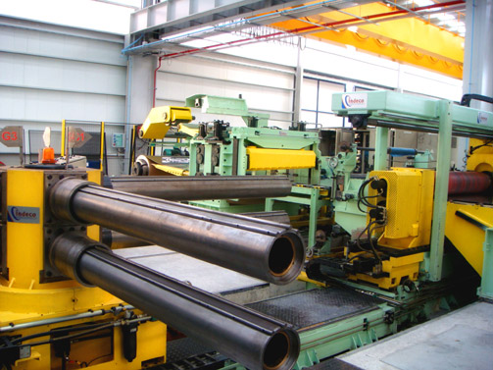
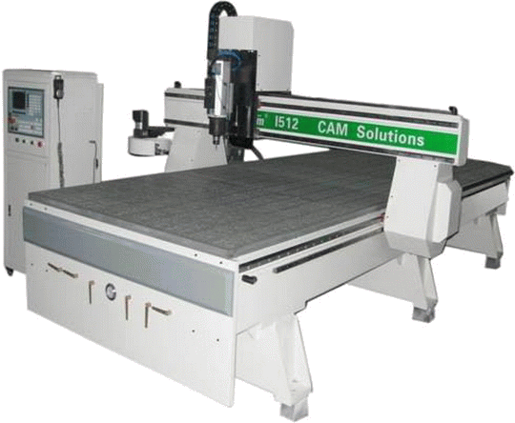
Tool Support
Usually classification trees and test cases are generated using a special tool
Supports drawing the classification trees
Allows automatic generation of test cases

Slide 22
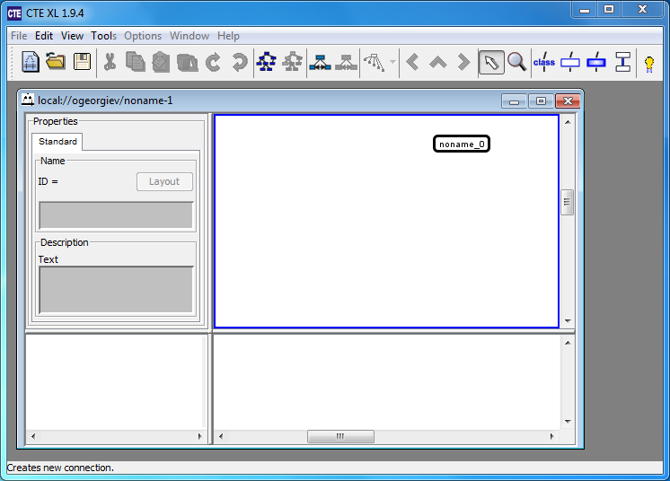
CTE XL
Graphical Editor For Classification Trees

Slide 23
CTE XL
CTE XL is a graphical editor for classification trees
Has a free and a paid version
Source:
http://www.berner-mattner.com/en/berner-mattner-home/products/cte/index.html

Slide 24

Features of CTE
CTE XL supports the following features
Drawing and editing classification trees
Adding description and commentaries
Adding, repositioning trees, storing in libraries
Automated test case generation
User-defined dependency rules
Integration of requirement and test management tools

Slide 25

Models Of Test Generation
Minimal combination
Creates a test suite that uses every class from each classification at least once in a test case
Pairwise combination
Creates a test suite that uses every class pair from disjunctive classifications at least once in a test case

Slide 26
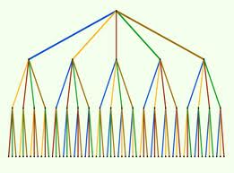
Models Of Test Generation (2)
Threewise combination (“triple-wise”)
Creates a test suite that uses every triple of classes from disjunctive classifications at least once in a test case
Complete combination
Creates a test suite that uses every possible combination of classes from disjunctive classification in a test case

Slide 27

Test Coverage
The objective of the Classification Tree Method is to determine a sufficient but minimum number of test case specifications
Well designed specifications reduce the number of tests

Slide 28


Some Useful Tips
Good Practices for Using CT

Slide 29

Some Useful Tips
If your trees become too large
Break it down with references to the higher level tree (folding)
Start off small (high level)
Give yourself time to apply the technique

Slide 30
Classification Trees Testing
?
?
?
?
?
Questions?
?
?
?
?
?
?

Slide 31
Exercises
Create a classification tree for a life insurance program that calculates insurance premiums based on the following factors:
Have the client been smoking (yes / no)
Is the client disabled (yes / no)
Have the client been diagnosed with life threatening disease (yes / no)
Continues …

Slide 32
Exercises (2)
Have the client been hospitalized in the past (yes / no)
BMI (Body-Mass Index) (<17 / 18-33 / 34-36 / 37-39 / >39)
Age (18-39 / 40-59 / >59)
Derive test cases by using every class from each classification at least once in a test case

Slide 33
Exercises (3)
Derive test cases for all pairs from the example bellow:
Suppose you need to test compatibility of various kiosk configurations based on three major factors, each set to one of the options shown:
Operating System: Windows XP or Linux
Browser: Internet Explorer (Windows only), Netscape, or Opera
Connection: DSL, dial-up, or cable

